Slide 1


2: Working with Pandas DataFrames

Slide 2

Working with Pandas DataFrames
The following topics will be covered in this lesson:
Pandas data structures
Creating DataFrame objects from files, API requests, SQL queries, and other Python objects
Inspecting DataFrame objects and calculating summary statistics
Grabbing subsets of the data via selection, slicing, indexing, and filtering
Adding and removing data
Notes:
The time has come for us to begin our journey into the pandas universe. This lesson will get us comfortable working with some of the basic, yet powerful, operations we will be performing when conducting our data analyses with pandas.
We will begin with an introduction to the main data structures we will encounter when working with pandas. Data structures provide us with a format for organizing, managing, and storing data. Knowledge of pandas data structures will prove infinitely helpful when it comes to troubleshooting or looking up how to perform an operation on the data. Keep in mind that these data structures are different from the standard Python data structures for a reason: they were created for specific analysis tasks. We must remember that a given method may only work on a certain data structure, so we need to be able to identify the best structure for the problem we are looking to solve.
Next, we will bring our first dataset into Python. We will learn how to collect data from an API, create DataFrame objects from other data structures in Python, read in files, and interact with databases. Initially, you may wonder why we would ever need to create a DataFrame object from other Python data structures; however, if we ever want to test something quickly, create our own data, pull data from an API, or repurpose Python code from another project, then we will find this knowledge indispensable. Finally, we will master ways to inspect, describe, filter, and summarize our data.

Slide 3

lesson materials
The files we will be working with in this lesson can be found in the GitHub repository at https://github.com/fenago/data-analysis-pandas
We will be working with earthquake data from the US Geological Survey (USGS) by using the USGS API and CSV files, which can be found in the data/ directory.
Notes:
There are four CSV files and a SQLite database file, all of which will be used at different points throughout this lesson. The earthquakes.csv file contains data that's been pulled from the USGS API for September 18, 2018 through October 13, 2018. For our discussion of data structures, we will work with the example_data.csv file, which contains five rows and a subset of the columns from the earthquakes.csv file. The tsunamis.csv file is a subset of the data in the earthquakes.csv file for all earthquakes that were accompanied by tsunamis during the aforementioned date range. The quakes.db file contains a SQLite database with a single table for the tsunamis data. We will use this to learn how to read from and write to a database with pandas. Lastly, the parsed.csv file will be used for the end-of-lesson exercises, and we will also walk through the creation of it during this lesson.
The accompanying code for this lesson has been divided into six Jupyter Notebooks, which are numbered in the order they are to be used. They contain the code snippets we will be running throughout this lesson, along with the full output of any command that has to be trimmed for this text. Each time we are to switch notebooks, the text will indicate to do so.
In the 1-pandas_data_structures.ipynb notebook, we will start learning about the main pandas data structures. Afterward, we will discuss the various ways to create DataFrame objects in the 2-creating_dataframes.ipynb notebook. Our discussion on this topic will continue in the 3-making_dataframes_from_api_requests.ipynb notebook, where we will explore the USGS API to gather data for use with pandas. After learning about how we can collect our data, we will begin to learn how to conduct exploratory data analysis (EDA) in the 4-inspecting_dataframes.ipynb notebook. Then, in the 5-subsetting_data.ipynb notebook, we will discuss various ways to select and filter data. Finally, we will learn how to add and remove data in the 6-adding_and_removing_data.ipynb notebook. Let's get started.

Slide 4
Pandas data structures
The aforementioned data structures are implemented as Python classes; when we actually create one, they are referred to as objects or instances.
This is an important distinction, since, as we will see, some actions can be performed using the object itself (a method), whereas others will require that we pass our object in as an argument to some function.
Notes:
Python has several data structures already, such as tuples, lists, and dictionaries. Pandas provides two main structures to facilitate working with data: Series and DataFrame. The Series and DataFrame data structures each contain another pandas data structure, Index, that we must also be aware of. However, in order to understand these data structures, we need to first take a look at NumPy (https://numpy.org/doc/stable/), which provides the n-dimensional arrays that pandas builds upon.
Note that, in Python, class names are traditionally written in CapWords, while objects are written in snake_case. (More Python style guidelines can be found at https://www.python.org/dev/peps/pep-0008/.)
We use a pandas function to read a CSV file into an object of the DataFrame class, but we use methods on our DataFrame objects to perform actions on them, such as dropping columns or calculating summary statistics. With pandas, we will often want to access the attributes of the object we are working with. This won't generate an action as a method or function would; rather, we will be given information about our pandas object, such as dimensions, column names, data types, and whether it is empty.
Important note
For the remainder of this course, we will refer to DataFrame objects as dataframes, Series objects as series, and Index objects as index/indices, unless we are referring to the class itself.
For this section, we will work in the 1-pandas_data_structures.ipynb notebook. To begin, we will import numpy and use it to read the contents of the example_data.csv file into a numpy.array object. The data comes from the USGS API for earthquakes (source: https://earthquake.usgs.gov/fdsnws/event/1/).

Slide 5
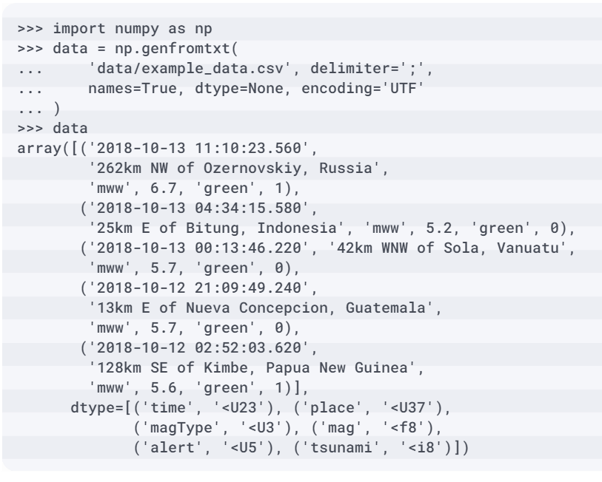
Pandas data structures
Note that this is the only time we will use NumPy to read in a file and that this is being done for illustrative purposes only; the important part is to look at the way the data is represented with NumPy:

Slide 6
Pandas data structures
We now have our data in a NumPy array.
Using the shape and dtype attributes, we can gather information about the dimensions of the array and the data types it contains, respectively:
>>> data.shape
(5,)
>>> data.dtype
dtype([('time', '<U23'), ('place', '<U37'), ('magType', '<U3'),
('mag', '<f8'), ('alert', '<U5'), ('tsunami', '<i8')])
Notes:
Each of the entries in the array is a row from the CSV file. NumPy arrays contain a single data type (unlike lists, which allow mixed types); this allows for fast, vectorized operations. When we read in the data, we got an array of numpy.void objects, which are used to store flexible types. This is because NumPy had to store several different data types per row: four strings, a float, and an integer. Unfortunately, this means that we can't take advantage of the performance improvements NumPy provides for single data type objects.
Say we want to find the maximum magnitude—we can use a list comprehension (https://www.python.org/dev/peps/pep-0202/) to select the third index of each row, which is represented as a numpy.void object. This makes a list, meaning that we can take the maximum using the max() function.

Slide 7
Pandas data structures
We can use the %%timeit magic command from IPython (a special command preceded by %) to see how long this implementation takes (times will vary):
>>> %%timeit
>>> max([row[3] for row in data])
9.74 µs ± 177 ns per loop
(mean ± std. dev. of 7 runs, 100000 loops each)
Notes:
Note that we should use a list comprehension whenever we would write a for loop with just a single line under it or want to run an operation against the members of some initial list. This is a rather simple list comprehension, but we can make them more complex with the addition of if...else statements. List comprehensions are an extremely powerful tool to have in our arsenal. More information can be found in the Python documentation at https://docs.python.org/3/tutorial/datastructures.html#list-comprehensions.
Tip
IPython (https://ipython.readthedocs.io/en/stable/index.html) provides an interactive shell for Python. Jupyter Notebooks are built on top of IPython. While knowledge of IPython is not required for this course, it can be helpful to be familiar with some of its functionality. IPython includes a tutorial in their documentation at https://ipython.readthedocs.io/en/stable/interactive/.
If we create a NumPy array for each column instead, this operation is much easier (and more efficient) to perform. To do so, we will use a dictionary comprehension (https://www.python.org/dev/peps/pep-0274/) to make a dictionary where the keys are the column names and the values are NumPy arrays of the data.

Slide 8
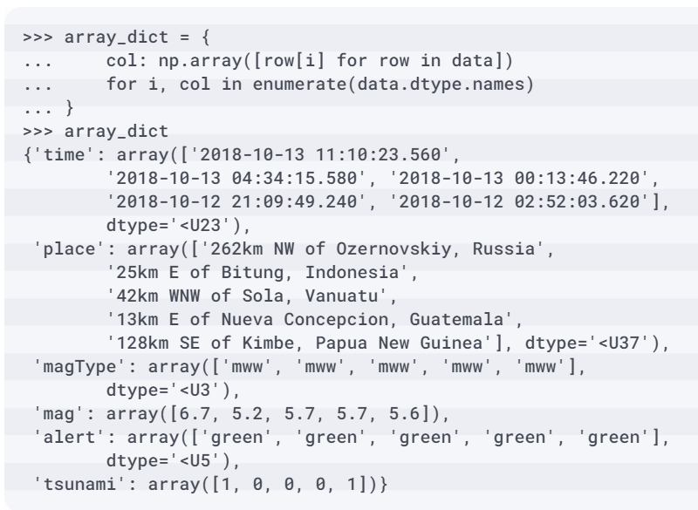
Pandas data structures
Again, the important part here is how the data is now represented using NumPy:

Slide 9
Pandas data structures
Grabbing the maximum magnitude is now simply a matter of selecting the mag key and calling the max() method on the NumPy array.
This is nearly twice as fast as the list comprehension implementation, when dealing with just five entries—imagine how much worse the first attempt will perform on large datasets:
>>> %%timeit
>>> array_dict['mag'].max()
5.22 µs ± 100 ns per loop
(mean ± std. dev. of 7 runs, 100000 loops each)
Notes:
However, this representation has other issues. Say we wanted to grab all the information for the earthquake with the maximum magnitude; how would we go about that? We need to find the index of the maximum, and then for each of the keys in the dictionary, grab that index.

Slide 10
Pandas data structures
The result is now a NumPy array of strings (our numeric values were converted), and we are now in the format that we saw earlier:
>>> np.array([
... value[array_dict['mag'].argmax()]
... for key, value in array_dict.items()
... ])
array(['2018-10-13 11:10:23.560',
'262km NW of Ozernovskiy, Russia',
'mww', '6.7', 'green', '1'], dtype='<U31')
Notes:
Consider how we would go about sorting the data by magnitude from smallest to largest. In the first representation, we would have to sort the rows by examining the third index. With the second representation, we would have to determine the order of the indices from the mag column, and then sort all the other arrays with those same indices. Clearly, working with several NumPy arrays containing different data types at once is a bit cumbersome; however, pandas builds on top of NumPy arrays to make this easier. Let's start our exploration of pandas with an overview of the Series data structure.

Slide 11
Series
The Series class provides a data structure for arrays of a single type, just like the NumPy array.
However, it comes with some additional functionality.
This one-dimensional representation can be thought of as a column in a spreadsheet.

Slide 12
Series
We have a name for our column, and the data we hold in it is of the same type (since we are measuring the same variable):
>>> import pandas as pd
>>> place = pd.Series(array_dict['place'], name='place')
>>> place
0 262km NW of Ozernovskiy, Russia
1 25km E of Bitung, Indonesia
2 42km WNW of Sola, Vanuatu
3 13km E of Nueva Concepcion, Guatemala
4 128km SE of Kimbe, Papua New Guinea
Name: place, dtype: object
Notes:
Note the numbers on the left of the result; these correspond to the row number in the original dataset (offset by 1 since, in Python, we start counting at 0). These row numbers form the index, which we will discuss in the following section. Next to the row numbers, we have the actual value of the row, which, in this example, is a string indicating where the earthquake occurred. Notice that we have dtype: object next to the name of the Series object; this is telling us that the data type of place is object. A string will be classified as object in pandas.

Slide 13
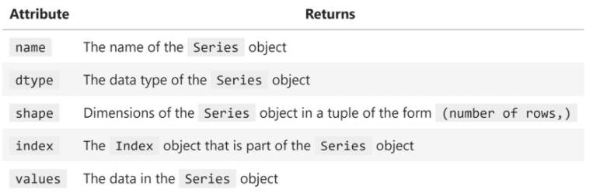
Series
To access attributes of the Series object, we use attribute notation of the form <object>.<attribute_name>.
The following are some common attributes we will access.
Notice that dtype and shape are available, just as we saw with the NumPy array:
Notes:
Important note
For the most part, pandas objects use NumPy arrays for their internal data representations. However, for some data types, pandas builds upon NumPy to create its own arrays (https://pandas.pydata.org/pandas-docs/stable/reference/arrays.html). For this reason, depending on the data type, values can return either a pandas.array or a numpy.array object. Therefore, if we need to ensure we get a specific type back, it is recommended to use the array attribute or to_numpy() method, respectively, instead of values.
Be sure to bookmark the pandas.Series documentation (https://pandas.pydata.org/pandas-docs/stable/reference/api/pandas.Series.html) for reference later. It contains more information on how to create a Series object, the full list of attributes and methods that are available, as well as a link to the source code. With this high-level introduction to the Series class, we are ready to move on to the Index class.

Slide 14
Index
The addition of the Index class makes the Series class significantly more powerful than a NumPy array.
The Index class gives us row labels, which enable selection by row. Depending on the type, we can provide a row number, a date, or even a string to select our row.
It plays a key role in identifying entries in the data and is used for a multitude of operations in pandas, as we will see throughout this course.

Slide 15
Index
We can access the index through the index attribute:
>>> place_index = place.index
>>> place_index
RangeIndex(start=0, stop=5, step=1)
Notes:
Note that this is a RangeIndex object. Its values start at 0 and end at 4. The step of 1 indicates that the indices are all 1 apart, meaning that we have all the integers in that range. The default index class is RangeIndex; however, we can change the index, as we will discuss in lesson 3, Data Wrangling with Pandas. Often, we will either work with an Index object of row numbers or date(time)s.

Slide 16
Index
As with Series objects, we can access the underlying data via the values attribute.
Note that this Index object is built on top of a NumPy array:
>>> place_index.values
array([0, 1, 2, 3, 4], dtype=int64)

Slide 17
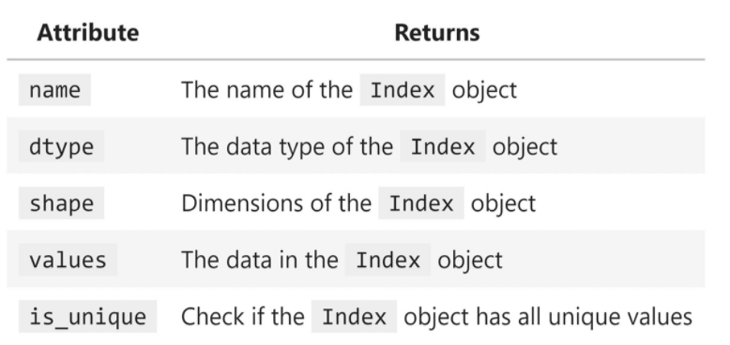
Index
Some of the useful attributes of Index objects include the following:

Slide 18
Index
Both NumPy and pandas support arithmetic operations, which will be performed element-wise.
NumPy will use the position in the array for this:
>>> np.array([1, 1, 1]) + np.array([-1, 0, 1])
array([0, 1, 2])
Notes:
With pandas, this element-wise arithmetic is performed on matching index values. If we add a Series object with an index from 0 to 4 (stored in x) and another, y, from 1 to 5, we will only get results were the indices align (1 through 4).

Slide 19
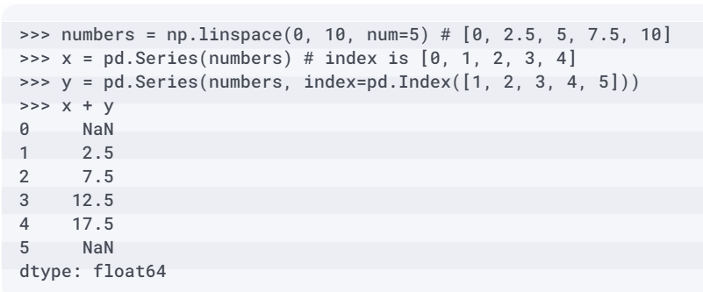
Index
In Data Wrangling with Pandas, we will discuss some ways to change and align the index so that we can perform these types of operations without losing data:
Notes:
Now that we have had a primer on both the Series and Index classes, we are ready to learn about the DataFrame class. Note that more information on the Index class can be found in the respective documentation at https://pandas.pydata.org/pandas-docs/stable/reference/api/pandas.Index.html.

Slide 20
DataFrame
With the Series class, we essentially had columns of a spreadsheet, with the data all being of the same type.
The DataFrame class builds upon the Series class and can have many columns, each with its own data type; we can think of it as representing the spreadsheet as a whole.
We can turn either of the NumPy representations we built from the example data into a DataFrame object:
>>> df = pd.DataFrame(array_dict)
>>> df
Notes:
This gives us a dataframe of six series. Note the column before the time column; this is the Index object for the rows. When creating a DataFrame object, pandas aligns all the series to the same index.

Slide 21
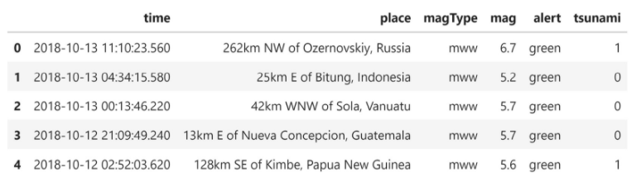
DataFrame
In this case, it is just the row number, but we could easily use the time column for this, which would enable some additional pandas features, as we will see in Aggregating Pandas DataFrames:

Slide 22
DataFrame
Our columns each have a single data type, but they don't all share the same data type:
>>> df.dtypes
time object
place object
magType object
mag float64
alert object
tsunami int64
dtype: object

Slide 23
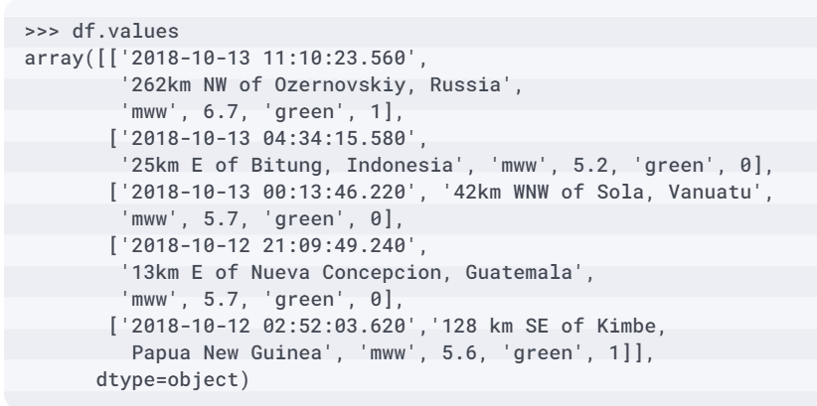
DataFrame
The values of the dataframe look very similar to the initial NumPy representation we had:

Slide 24
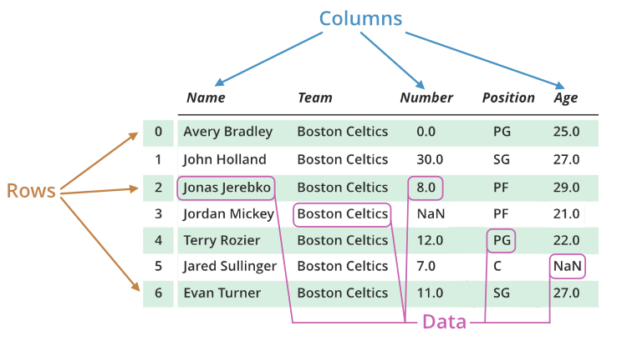
DataFrame
We can access the column names via the columns attribute.
Note that they are actually stored in an Index object as well:
>>> df.columns
Index(['time', 'place', 'magType', 'mag', 'alert', 'tsunami'],
dtype='object')

Slide 25
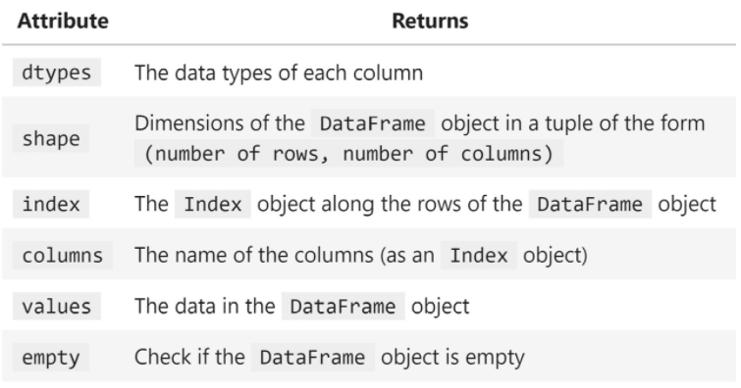
DataFrame
The following are some commonly used dataframe attributes:

Slide 26
DataFrame
Note that we can also perform arithmetic on dataframes.
For example, we can add df to itself, which will sum the numeric columns and concatenate the string columns:
>>> df + df

Slide 27
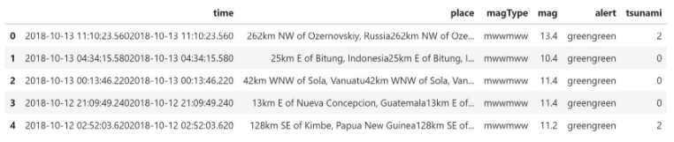
DataFrame
Pandas will only perform the operation when both the index and column match.
Here, pandas concatenated the string columns (time, place, magType, and alert) across dataframes.
The numeric columns (mag and tsunami) were summed:
Notes:
More information on DataFrame objects and all the operations that can be performed directly on them is available in the official documentation at https://pandas.pydata.org/pandas-docs/stable/reference/api/pandas.DataFrame.html; be sure to bookmark it for future reference. Now, we are ready to begin learning how to create DataFrame objects from a variety of sources.

Slide 28
Creating a pandas DataFrame
Let's now turn to the next notebook,
2-creating_dataframes.ipynb, and import the packages we will need for the upcoming examples.
We will be using datetime from the Python standard library, along with the third-party packages numpy and pandas:
>>> import datetime as dt
>>> import numpy as np
>>> import pandas as pd
Notes:
https://github.com/fenago/data-analysis-pandas/tree/master/lab_02
Now that we understand the data structures we will be working with, we can discuss the different ways we can create them. Before we dive into the code however, it's important to know how to get help right from Python. Should we ever find ourselves unsure of how to use something in Python, we can utilize the built-in help() function. We simply run help(), passing in the package, module, class, object, method, or function that we want to read the documentation on. We can, of course, look up the documentation online; however, in most cases, the docstrings (the documentation text written in the code) that are returned with help() will be equivalent to this since they are used to generate the documentation.
Assuming we first ran import pandas as pd, we can run help(pd) to display information about the pandas package; help(pd.DataFrame) for all the methods and attributes of DataFrame objects (note we can also pass in a DataFrame object instead); and help(pd.read_csv) to learn more about the pandas function for reading CSV files into Python and how to use it. We can also try using the dir() function and the __dict__ attribute, which will give us a list or dictionary of what's available, respectively; these might not be as useful as the help() function, though.
Additionally, we can use ? and ?? to get help, thanks to IPython, which is part of what makes Jupyter Notebooks so powerful. Unlike the help() function, we can use question marks by putting them after whatever we want to know more about, as if we were asking Python a question; for example, pd.read_csv? and pd.read_csv??. These three will yield slightly different outputs: help() will give us the docstring; ? will give the docstring, plus some additional information, depending on what we are inquiring about; and ?? will give us even more information and, if possible, the source code behind it.
Important note
We have aliased each of our imports. This allows us to use the pandas package by referring to it with the alias we assign to be pd, which is the most common way of importing it. In fact, we can only refer to it as pd, since that is what we imported into the namespace. Packages need to be imported before we can use them; installation puts the files we need on our computer, but, in the interest of memory, Python won't load every installed package when we start it up—just the ones we tell it to.
We are now ready to begin using pandas. First, we will learn how to create pandas objects from other Python objects. Then, we will learn how to do so with flat files, tables in a database, and responses from API requests.

Slide 29

From a Python object
To ensure that the result is reproducible, we will set the seed here.
The seed gives a starting point for the generation of pseudorandom numbers.
No algorithms for random number generation are truly random—they are deterministic, so by setting this starting point, the numbers that are generated will be the same each time the code is run.
Notes:
Before we cover all the ways we can create a DataFrame object from a Python object, we should learn how to make a Series object. Remember that a Series object is essentially a column in a DataFrame object, so, once we know this, it should be easy to understand how to create a DataFrame object. Say that we wanted to create a series of five random numbers between 0 and 1. We could use NumPy to generate the random numbers as an array and create the series from that.
Tip
NumPy makes it very easy to generate numerical data. Aside from generating random numbers, we can use it to get evenly-spaced numbers in a certain range with the np.linspace() function; obtain a range of integers with the np.arange() function; sample from the standard normal with the np.random.normal() function; and easily create arrays of all zeros with the np.zeros() function and all ones with the np.ones() function. We will be using NumPy throughout this course.

Slide 30

From a Python object
This is good for testing things, but not for simulation (where we want randomness), which we will look at in Rule-Based Anomaly Detection.
In this fashion, we can make a Series object with any list-like structure (such as NumPy arrays):
>>> np.random.seed(0) # set a seed for reproducibility
>>> pd.Series(np.random.rand(5), name='random')
0 0.548814
1 0.715189
2 0.602763
3 0.544883
4 0.423655
Name: random, dtype: float64
Notes:
Making a DataFrame object is an extension of making a Series object; it will be composed of one or more series, and each will be distinctly named. This should remind us of dictionary-like structures in Python: the keys are the column names, and the values are the contents of the columns. Note that if we want to turn a single Series object into a DataFrame object, we can use its to_frame() method.
Tip
In computer science, a constructor is a piece of code that initalizes new instances of a class, preparing them for use. Python classes implement this with the __init__() method. When we run pd.Series(), Python calls pd.Series.__init__(), which contains instructions for instantiating a new Series object. We will learn more about the __init__() method in lesson 7, Financial Analysis – Bitcoin and the Stock Market.

Slide 31
From a Python object
Since columns can all be different data types, let's get a little fancy with this example.
We are going to create a DataFrame object containing three columns, with five observations each:
random: Five random numbers between 0 and 1 as a NumPy array
text: A list of five strings or None
truth: A list of five random Booleans
Notes:
We will also create a DatetimeIndex object with the pd.date_range() function. The index will contain five dates (periods=5), all one day apart (freq='1D'), ending with April 21, 2019 (end), and will be called date. Note that more information on the values the pd.date_range() function accepts for frequencies can be found at https://pandas.pydata.org/pandas-docs/stable/user_guide/timeseries.html#offset-aliases.

Slide 32
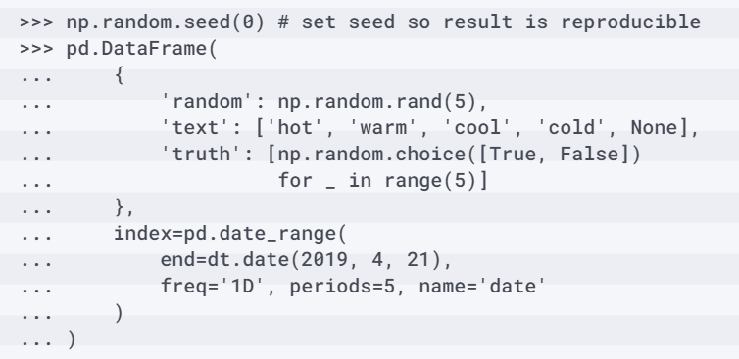
From a Python object
All we have to do is package the columns in a dictionary using the desired column names as the keys and pass this in when we call the pd.DataFrame() constructor.
The index gets passed as the index argument:
Notes:
Important note
By convention, we use _ to hold variables in a loop that we don't care about. Here, we use range() as a counter, and its values are unimportant. More information on the roles _ plays in Python can be found at https://hackernoon.com/understanding-the-underscore-of-python-309d1a029edc.

Slide 33
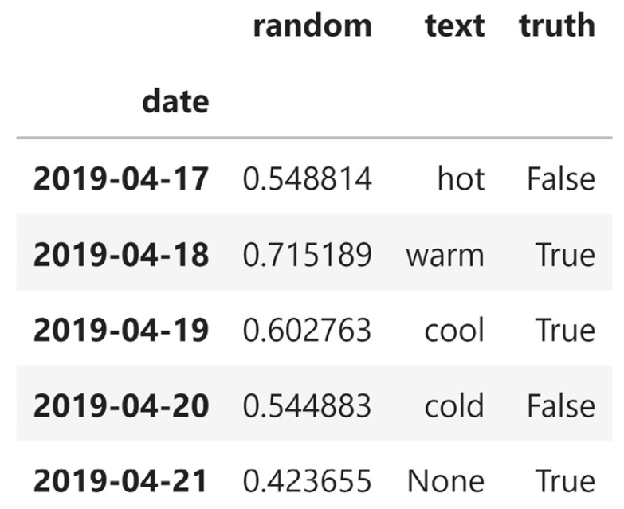
From a Python object
Having dates in the index makes it easy to select entries by date (or even in a date range), as we will see in Data Wrangling with Pandas:

Slide 34
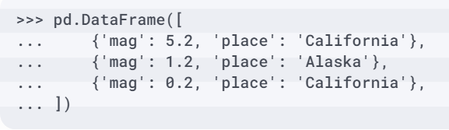
From a Python object
In cases where the data isn't a dictionary, but rather a list of dictionaries, we can still use pd.DataFrame().
Data in this format is what we would expect when consuming from an API.
Each entry in the list will be a dictionary, where the keys of the dictionary are the column names and the values of the dictionary are the values for that column at that index:

Slide 35
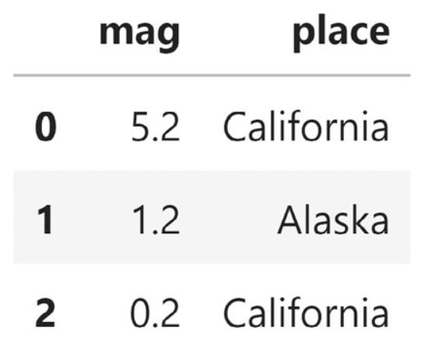
From a Python object
This gives us a dataframe of three rows (one for each entry in the list) with two columns (one for each key in the dictionaries):

Slide 36
From a Python object
In fact, pd.DataFrame() also works for lists of tuples.
Note that we can also pass in the column names as a list through the columns argument:
>>> list_of_tuples = [(n, n**2, n**3) for n in range(5)]
>>> list_of_tuples
[(0, 0, 0), (1, 1, 1), (2, 4, 8), (3, 9, 27), (4, 16, 64)]
>>> pd.DataFrame(
... list_of_tuples,
... columns=['n', 'n_squared', 'n_cubed']
... )

Slide 37
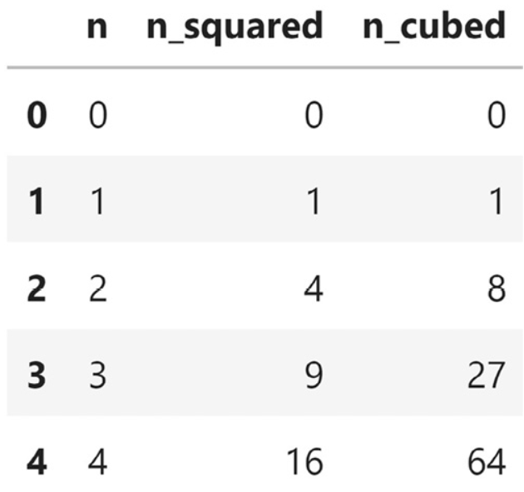
From a Python object
Each tuple is treated like a record and becomes a row in the dataframe:

Slide 38
From a Python object
We also have the option of using pd.DataFrame() with NumPy arrays:
>>> pd.DataFrame(
... np.array([
... [0, 0, 0],
... [1, 1, 1],
... [2, 4, 8],
... [3, 9, 27],
... [4, 16, 64]
... ]), columns=['n', 'n_squared', 'n_cubed']
... )
Notes:
This will have the effect of stacking each entry in the array as rows in a dataframe, giving us a result that's identical to Figure

Slide 39
From a file
The data we want to analyze will most often come from outside Python.
In many cases, we may obtain a data dump from a database or website and bring it into Python to sift through it.
A data dump gets its name from containing a large amount of data (possibly at a very granular level) and often not discriminating against any of it initially; for this reason, they can be unwieldy.
Notes:
Often, these data dumps will come in the form of a text file (.txt) or a CSV file (.csv). Pandas provides many methods for reading in different types of files, so it is simply a matter of looking up the one that matches our file format. Our earthquake data is a CSV file; therefore, we use the pd.read_csv() function to read it in. However, we should always do an initial inspection of the file before attempting to read it in; this will inform us of whether we need to pass additional arguments, such as sep to specify the delimiter or names to provide the column names ourselves in the absence of a header row in the file.
Important note
Windows users: Depending on your setup, the commands in the next few code blocks may not work. The notebook contains alternatives if you encounter issues.
We can perform our due diligence directly in our Jupyter Notebook thanks to IPython, provided we prefix our commands with ! to indicate they are to be run as shell commands. First, we should check how big the file is, both in terms of lines and in terms of bytes.

Slide 40

From a file
To check the number of lines, we use the wc utility (word count) with the –l flag to count the number of lines.
We have 9,333 rows in the file:
>>> !wc -l data/earthquakes.csv
9333 data/earthquakes.csv

Slide 41

From a file
Now, let's check the file's size.
For this task, we will use ls on the data directory.
This will show us the list of files in that directory.
We can add the -lh flag to get information about the files in a human-readable format.
Finally, we send this output to the grep utility, which will help us isolate the files we want.
This tells us that the earthquakes.csv file is 3.4 MB:
>>> !ls -lh data | grep earthquakes.csv
-rw-r--r-- 1 stefanie stefanie 3.4M ... earthquakes.csv

Slide 42
From a file
Note that IPython also lets us capture the result of the command in a Python variable, so if we aren't comfortable with pipes (|) or grep, we can do the following:
>>> files = !ls -lh data
>>> [file for file in files if 'earthquake' in file]
['-rw-r--r-- 1 stefanie stefanie 3.4M ... earthquakes.csv']

Slide 43
From a file
Now, let's take a look at the top few rows to see if the file comes with headers.
>>> !head -n 2 data/earthquakes.csv
alert,cdi,code,detail,dmin,felt,gap,ids,mag,magType,mmi,net,nst,place,rms,sig,sources,status,time,title,tsunami,type,types,tz,updated,url
,,37389218,https://earthquake.usgs.gov/[...],0.008693,,85.0,",ci37389218,",1.35,ml,,ci,26.0,"9km NE of Aguanga, CA",0.19,28,",ci,",automatic,1539475168010,"M 1.4 - 9km NE of Aguanga, CA",0,earthquake,",geoserve,nearby-cities,origin,phase-data,",-480.0,1539475395144,https://earthquake.usgs.gov/earthquakes/eventpage/ci37389218
Notes:
We will use the head utility and specify the number of rows with the -n flag. This tells us that the first row contains the headers for the data and that the data is delimited with commas (just because the file has the .csv extension does not mean it is comma-delimited)
Note that we should also check the bottom rows to make sure there is no extraneous data that we will need to ignore by using the tail utility. This file is fine, so the result won't be reproduced here; however, the notebook contains the result.
Lastly, we may be interested in seeing the column count in our data. While we could just count the fields in the first row of the result of head, we have the option of using the awk utility (for pattern scanning and processing) to count our columns. The -F flag allows us to specify the delimiter (a comma, in this case). Then, we specify what to do for each record in the file. We choose to print NF, which is a predefined variable whose value is the number of fields in the current record. Here, we say exit immediately after the print so that we print the number of fields in the first row of the file; then, we stop.

Slide 44
From a file
This will look a little complicated, but this is by no means something we need to memorize:
>>> !awk -F',' '{print NF; exit}' data/earthquakes.csv
26

Slide 45
From a file
Since we know that the first line of the file contains headers and that the file is comma-separated, we can also count the columns by using head to get the headers and Python to parse them:
>>> headers = !head -n 1 data/earthquakes.csv
>>> len(headers[0].split(','))
26
Notes:
Important note
The ability to run shell commands directly from our Jupyter Notebook dramatically streamlines our workflow. However, if we don't have past experience with the command line, it may be complicated to learn these commands initially. IPython has some helpful information on running shell commands in their documentation at https://ipython.readthedocs.io/en/stable/interactive/reference.html#system-shell-access.

Slide 46
From a file
To summarize, we now know that the file is 3.4 MB and is comma-delimited with 26 columns and 9,333 rows, with the first one being the header.
This means that we can use the pd.read_csv() function with the defaults:
>>> df = pd.read_csv('earthquakes.csv')

Slide 47
From a file
Note that we aren't limited to reading in data from files on our local machines; file paths can be URLs as well.
As an example, let's read in the same CSV file from GitHub:
>>> df = pd.read_csv(
... ‘https://github.com/fenago/’
... 'data-analysis-pandas'
... '/blob/master/ch_02/data/earthquakes.csv?raw=True'
... )

Slide 48
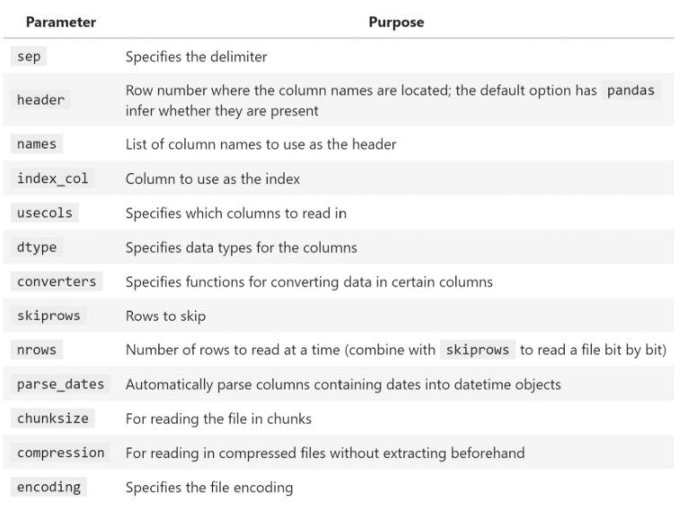
From a file
Pandas is usually very good at figuring out which options to use based on the input data, so we often won't need to add arguments to this call; however, there are many options available should we need them, some of which include the following:
Notes:
Throughout this course, we will be working with CSV files; however, note that we can use the read_excel() function to read in Excel files, the read_json() function for JSON (JavaScript Object Notation) files, and for other delimited files, such as tab (\t), we can use the read_csv() function with the sep argument equal to the delimiter.
It would be remiss if we didn't also learn how to save our dataframe to a file so that we can share it with others. To write our dataframe to a CSV file, we call its to_csv() method. We have to be careful here; if our dataframe's index is just row numbers, we probably don't want to write that to our file (it will have no meaning to the consumers of the data), but it is the default.

Slide 49
From a file
We can write our data without the index by passing in index=False:
>>> df.to_csv('output.csv', index=False)
Notes:
As with reading from files, Series and DataFrame objects have methods to write data to Excel (to_excel()) and JSON files (to_json()). Note that, while we use functions from pandas to read our data in, we must use methods to write our data; the reading functions create the pandas objects that we want to work with, but the writing methods are actions that we take using the pandas object.
Pandas provides us with capabilities to read and write from many other data sources, including databases, which we will discuss next; pickle files (containing serialized Python objects—see the Further reading section for more information); and HTML pages. Be sure to check out the following resource in the pandas documentation for the full list of capabilities: https://pandas.pydata.org/pandas-docs/stable/user_guide/io.html.

Slide 50
Describing and summarizing the data
The next step is to calculate summary statistics, which will help us get to know our data better.
Pandas provides several methods for easily doing so; one such method is describe(), which also works on Series objects if we are only interested in a particular column.
Let's get a summary of the numeric columns in our data:
>>> df.describe()
Notes:
So far, we've examined the structure of the DataFrame object we created from the earthquake data, but we don't know anything about the data other than what a couple of rows look like.

Slide 51
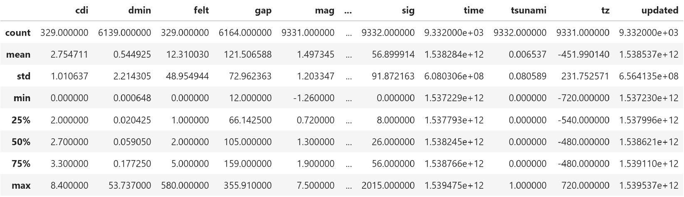
Describing and summarizing the data
This gives us the 5-number summary, along with the count, mean, and standard deviation of the numeric columns:
Notes:
Tip
If we want different percentiles, we can pass them in with the percentiles argument. For example, if we wanted only the 5th and 95th percentiles, we would run df.describe(percentiles=[0.05, 0.95]). Note we will still get the 50th percentile back because that is the median.

Slide 52

Describing and summarizing the data
By default, describe() won't give us any information about the columns of type object, but we can either provide include='all' as an argument or run it separately for the data of type np.object:
>>> df.describe(include=np.object)

Slide 53
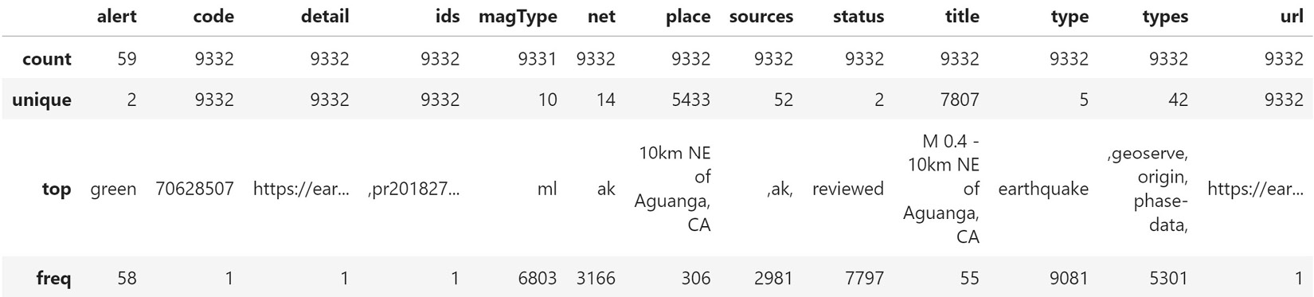
Describing and summarizing the data
When describing non-numeric data, we still get the count of non-null occurrences (count); however, instead of the other summary statistics, we get the number of unique values (unique), the mode (top), and the number of times the mode was observed (freq):
Notes:
Important note
The describe() method only gives us summary statistics for non-null values. This means that, if we had 100 rows and half of our data was null, then the average would be calculated as the sum of the 50 non-null rows divided by 50.
It is easy to get a snapshot of our data using the describe() method, but sometimes, we just want a particular statistic, either for a specific column or for all the columns.

Slide 54
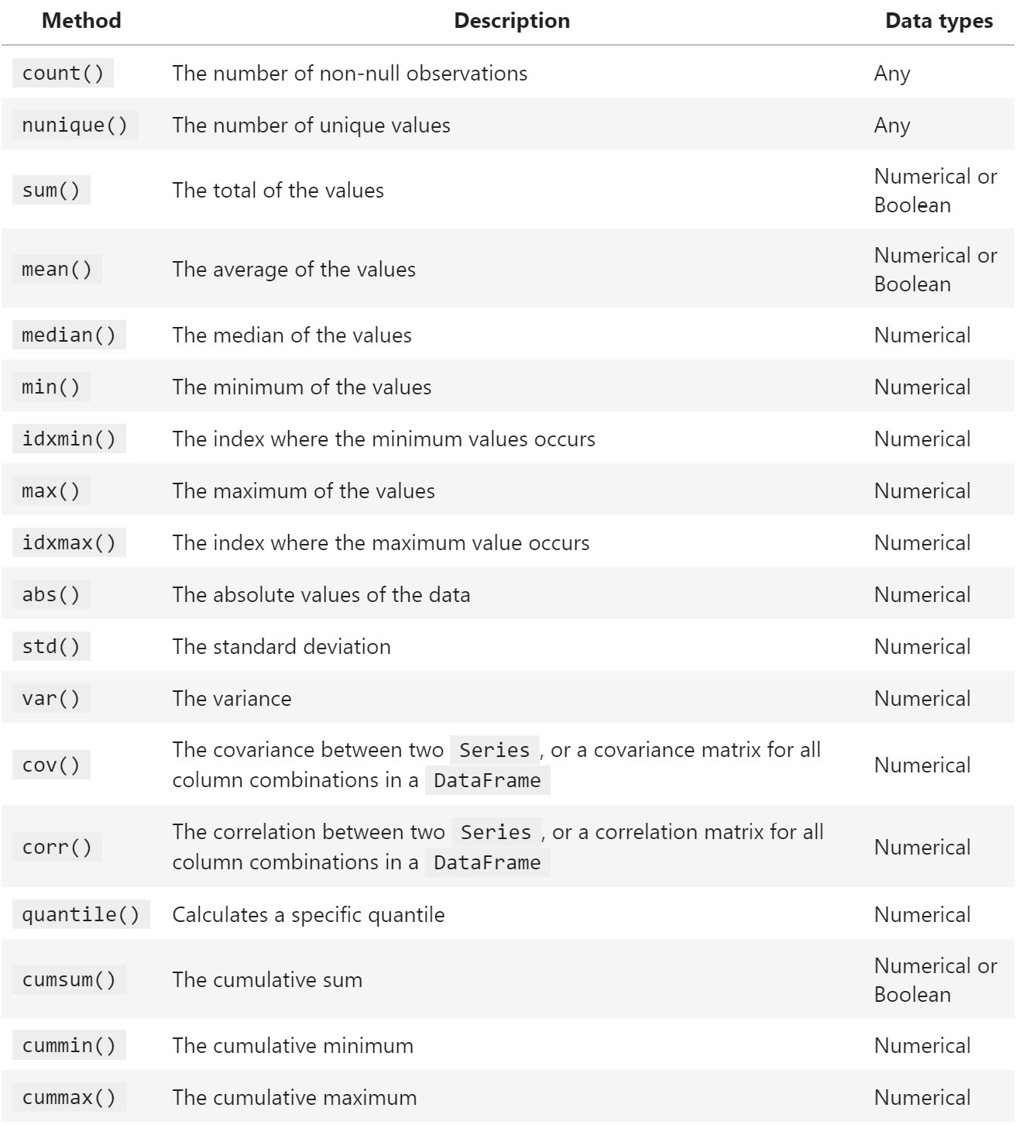
Describing and summarizing the data
Pandas makes this a cinch as well.
The following table includes methods that will work for both Series and DataFrame objects:
Notes:
Tip
Python makes it easy to count how many times something is True. Under the hood, True evaluates to 1 and False evaluates to 0. Therefore, we can run the sum() method on a series of Booleans and get the count of True outputs.

Slide 55
Describing and summarizing the data
With Series objects, we have some additional methods for describing our data:
unique(): Returns the distinct values of the column.
value_counts(): Returns a frequency table of the number of times each unique value in a given column appears, or, alternatively, the percentage of times each unique value appears when passed normalize=True.
mode(): Returns the most common value of the column.
Notes:
Consulting the USGS API documentation for the alert field (which can be found at https://earthquake.usgs.gov/data/comcat/data-eventterms.php#alert) tells us that it can be 'green', 'yellow', 'orange', or 'red' (when populated), and that it is the alert level from the Prompt Assessment of Global Earthquakes for Response (PAGER) earthquake impact scale. According to the USGS (https://earthquake.usgs.gov/data/pager/), "the PAGER system provides fatality and economic loss impact estimates following significant earthquakes worldwide." From our initial inspection of the data, we know that the alert column is a string of two unique values and that the most common value is 'green', with many null values.

Slide 56

Describing and summarizing the data
What is the other unique value, though?
>>> df.alert.unique()
array([nan, 'green', 'red'], dtype=object)

Slide 57

Describing and summarizing the data
Now that we understand what this field means and the values we have in our data, we expect there to be far more 'green' than 'red'; we can check our intuition with a frequency table by using value_counts().
Notice that we only get counts for the non-null entries:
>>> df.alert.value_counts()
green 58
red 1
Name: alert, dtype: int64

Slide 58
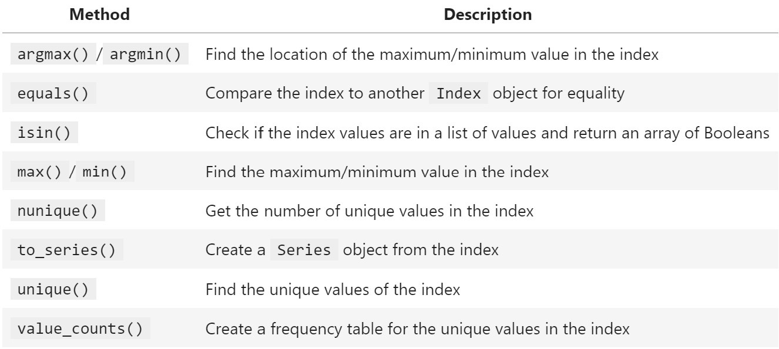
Describing and summarizing the data
Note that Index objects also have several methods that can help us describe and summarize our data:
Notes:
When we used unique() and value_counts(), we got a preview of how to select subsets of our data. Now, let's go into more detail and cover selection, slicing, indexing, and filtering.

Slide 59
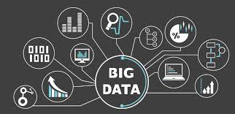
Grabbing subsets of the data
For this section, we will work in the 5-subsetting_data.ipynb notebook.
Our setup is as follows:
>>> import pandas as pd
>>> df = pd.read_csv('data/earthquakes.csv')
Notes:
So far, we have learned how to work with and summarize the data as a whole; however, we will often be interested in performing operations and/or analyses on subsets of our data. There are many types of subsets we may look to isolate from our data, such as selecting only specific columns or rows as a whole or when a specific criterion is met. In order to obtain subsets of the data, we need to be familiar with selection, slicing, indexing, and filtering.

Slide 60
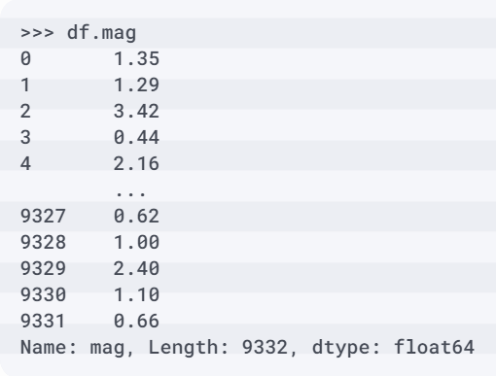
Selecting columns
Remember that a column is a Series object, so, for example, selecting the mag column in the earthquake data gives us the magnitudes of the earthquakes as a Series object:
Notes:
In the previous section, we saw an example of column selection when we looked at the unique values in the alert column; we accessed the column as an attribute of the dataframe.

Slide 61
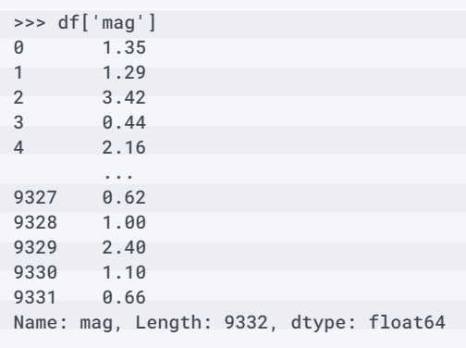
Selecting columns
Pandas provides us with a few ways to select columns.
An alternative to using attribute notation to select a column is to access it with a dictionary-like notation:
Notes:
Tip
We can also select columns using the get() method. This has the benefits of not raising an error if the column doesn't exist and allowing us to provide a backup value—the default is None. For example, if we call df.get('event', False), it will return False since we don't have an event column.

Slide 62
Selecting columns
Note that we aren't limited to selecting one column at a time.
By passing a list to the dictionary lookup, we can select many columns, giving us a DataFrame object that is a subset of our original dataframe:
>>> df[['mag', 'title']]

Slide 63
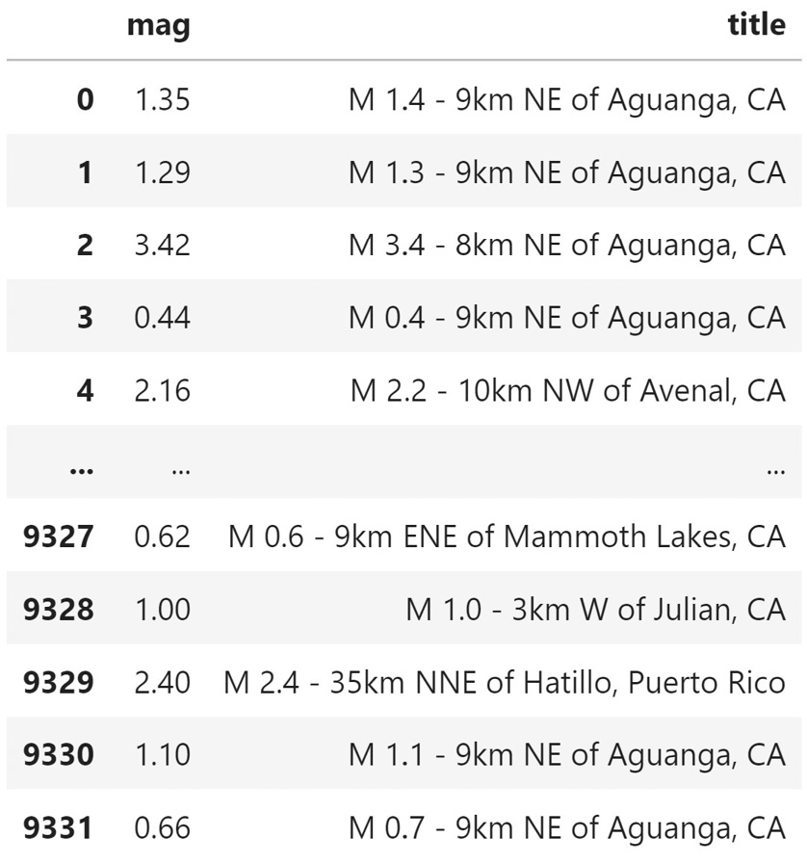
Selecting columns
This gives us the full mag and title columns from the original dataframe:

Slide 64
Selecting columns
String methods are a very powerful way to select columns.
For example, if we wanted to select all the columns that start with mag, along with the title and time columns, we would do the following:
>>> df[
... ['title', 'time']
... + [col for col in df.columns if col.startswith('mag')]
... ]

Slide 65
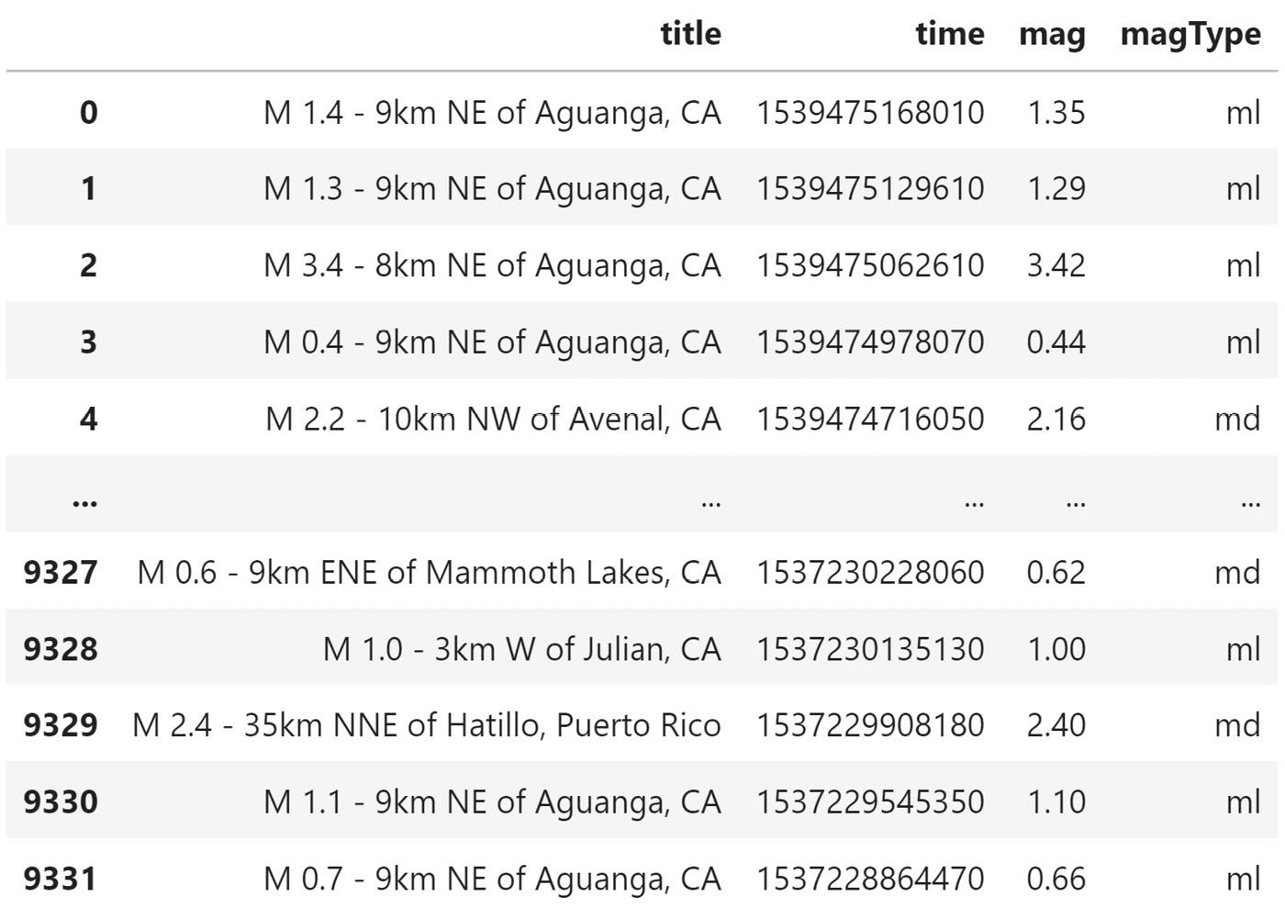
Selecting columns
We get back a dataframe composed of the four columns that matched our criteria.
Notice how the columns were returned in the order we requested, which is not the order they originally appeared in.
This means that if we want to reorder our columns, all we have to do is select them in the order we want them to appear:

Slide 66
Selecting columns
Let's break this example down.
We used a list comprehension to go through each of the columns in the dataframe and only keep the ones whose names started with mag:
>>> [col for col in df.columns if col.startswith('mag')]
['mag', 'magType']

Slide 67
Selecting columns
Then, we added this result to the other two columns we wanted to keep (title and time):
>>> ['title', 'time'] \
... + [col for col in df.columns if col.startswith('mag')]
['title', 'time', 'mag', 'magType']

Slide 68
Selecting columns
Finally, we were able to use this list to run the actual column selection on the dataframe, resulting in the dataframe in previous Figure:
>>> df[
... ['title', 'time']
... + [col for col in df.columns if col.startswith('mag')]
... ]
Notes:
Tip
A complete list of string methods can be found in the Python 3 documentation at https://docs.python.org/3/library/stdtypes.html#string-methods.

Slide 69
Adding and removing data
Should we find ourselves in a situation where we don't want to change the original data, but rather want to return a new copy of the data that has been modified, we must be sure to copy our dataframe before making any changes:
df_to_modify = df.copy()
Notes:
In the previous sections, we frequently selected a subset of the columns, but if columns/rows aren't useful to us, we should just get rid of them. We also frequently selected data based on the value of the mag column; however, if we had made a new column holding the Boolean values for later selection, we would have only needed to calculate the mask once. Very rarely will we get data where we neither want to add nor remove something.
Before we begin adding and removing data, it's important to understand that while most methods will return a new DataFrame object, some will be in-place and change our data. If we write a function where we pass in a dataframe and change it, it will change our original dataframe as well.
Important note
By default, df.copy() makes a deep copy of the dataframe, which allows us to make changes to either the copy or the original without repercussions. If we pass in deep=False, we can obtain a shallow copy—changes to the shallow copy affect the original and vice versa. We will almost always want the deep copy, since we can change it without affecting the original. More information can be found in the documentation at https://pandas.pydata.org/pandas-docs/stable/reference/api/pandas.DataFrame.copy.html.

Slide 70
Adding and removing data
We will once again be working with the earthquake data, but this time, we will only read in a subset of the columns:
>>> import pandas as pd
>>> df = pd.read_csv(
... 'data/earthquakes.csv',
... usecols=[
... 'time', 'title', 'place', 'magType',
... 'mag', 'alert', 'tsunami'
... ]
... )
Notes:
Now, let's turn to the final notebook, 6-adding_and_removing_data.ipynb, and get set up for the remainder of this lesson.

Slide 71
Deleting unwanted data
Note that if we aren't sure whether the column exists, we should put our column deletion code in a try...except block:
try:
del df['source']
except KeyError:
pass # handle the error here
Notes:
Earlier, we created the mag_negative column for filtering our dataframe; however, we no longer want this column as part of our dataframe.

Slide 72

Summary
In this lesson, we learned how to use pandas for the data collection portion of data analysis and to describe our data with statistics, which will be helpful when we get to the drawing conclusions phase.
We learned the main data structures of the pandas library, along with some of the operations we can perform on them.
Notes:
Next, we learned how to create DataFrame objects from a variety of sources, including flat files and API requests. Using earthquake data, we discussed how to summarize our data and calculate statistics from it. Subsequently, we addressed how to take subsets of data via selection, slicing, indexing, and filtering. Finally, we practiced adding and removing both columns and rows from our dataframe.
These tasks also form the backbone of our pandas workflow and the foundation for the new topics we will cover in the next few lessons on data wrangling, aggregation, and data visualization. Be sure to complete the exercises provided in the next section before moving on.

Slide 73
"Complete Exercises"

Slide 74
"Complete Lab 2"

